Slide 1
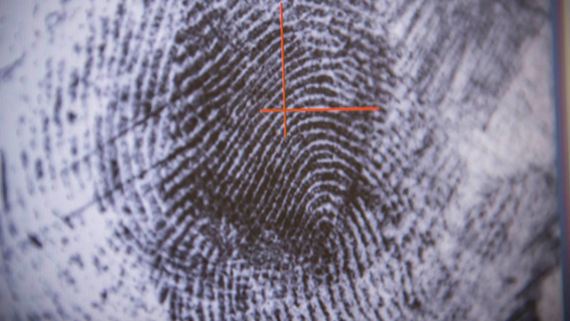
Image Identification

Slide 2
Introduction
Image identification, also known as image recognition, is the process of automatically identifying and detecting objects or patterns within digital images. This is typically accomplished using machine learning algorithms and computer vision techniques that analyze the visual features of an image, such as colors, textures, shapes, and edges, to identify specific objects or attributes within the image.

Slide 3
Steps to follow
Image identification using data science typically involves the following steps:
Gather a large dataset of images that you want to identify and ensure that each image is labeled with the correct identification or classification.
Pre-process the images to ensure that they are of uniform size, quality, and format. This may involve resizing, cropping, or adjusting the brightness and contrast of the images.
Use computer vision techniques to extract features from each image, such as color histograms, texture descriptors, or edge detection algorithms.
Select an appropriate machine learning algorithm or deep learning model for image classification, such as a convolutional neural network (CNN) or support vector machine (SVM).
Train the selected model on the pre-processed and feature-extracted dataset, using a training set of images labeled with their corresponding classifications.
Model evaluation: Evaluate the accuracy and performance of the trained model using a separate validation set of images.
Deployment: Deploy the trained model in a production environment, where it can be used to classify new, unseen images and provide real-time identification.
Image
Gather
Pre-Process
Feature
Model selection
Training
Model Evaluation
Deploy

Slide 4
Algorithms to achieve Image Identification
Convolutional Neural Networks (CNNs):
Support Vector Machines (SVMs):
K-Nearest Neighbors (KNN):
Random Forests
Deep Belief Networks (DBNs)
Gradient Boosting

Slide 5
Benefits
Efficiency: Image identification can automate the process of analyzing large volumes of images, reducing the time and cost of manual analysis.
Accuracy: Image identification algorithms can be highly accurate and can often identify objects or patterns within images that may be difficult or impossible for humans to detect.
Scalability: Image identification can be easily scaled up to handle large datasets of images, making it suitable for use in applications such as social media, e-commerce, and healthcare.
Improved decision-making: Image identification can provide valuable insights and information that can improve decision-making in a variety of industries, including manufacturing, agriculture, and security.
Increased safety: Image identification can be used to detect potential safety hazards in environments such as construction sites or manufacturing facilities, and to monitor and prevent accidents.
Enhanced user experience: Image identification can improve the user experience in applications such as e-commerce, by providing personalized recommendations based on the user's image preferences.

Slide 6

Disadvantages
Limited accuracy
Bias
Data requirements
Computing resources
Interpretability
Privacy concerns

Slide 7
Conclusion
Image identification using machine learning is a process of training algorithms to recognize and classify images based on patterns and features found in large datasets. Machine learning algorithms such as Convolutional Neural Networks (CNNs) have revolutionized the field of image identification, allowing computers to recognize and classify images with increasing accuracy and speed.
This technology has a wide range of applications in industries such as healthcare, finance, and retail, allowing organizations to make data-driven decisions based on image data. However, there are also limitations to image identification, including the need for large amounts of high-quality training data, the potential for bias and errors in the algorithms, and ethical concerns around privacy and fairness.
Overall, image identification using machine learning has the potential to provide significant benefits and insights for organizations but requires careful consideration and responsible use.

